Slide 1


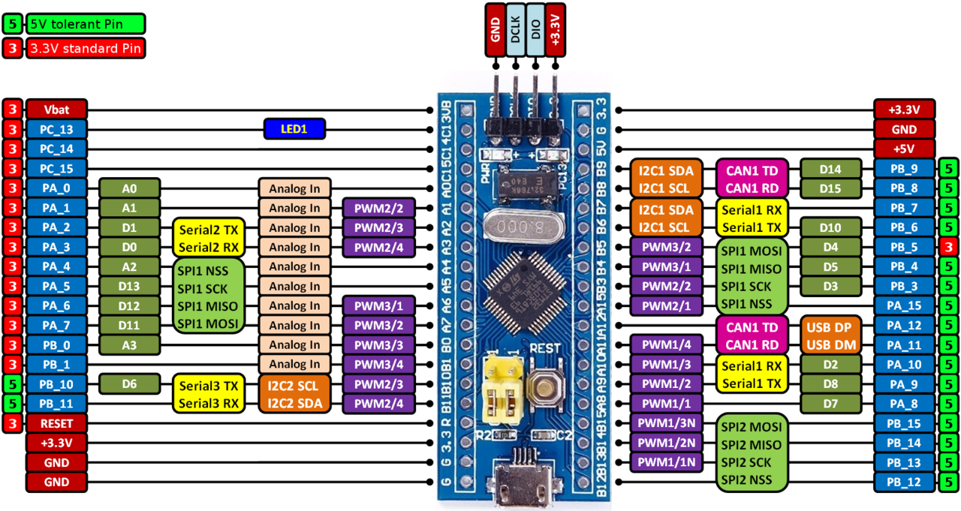
STM32 – ARM CORTEX M
LAB 2:
GPIO – 7 SEG
- 14 SEG
STM32 EMBEDDED PROGRAMING
DO TRUNG HAU

Slide 2

CONTENTS
1. SCAN 8 LED 7 SEG IN PARALLEL
2. SCAN 8 LED 7 SEG IN SERIAL
3. SCAN 8 LED 14 SEG IN SERIAL
STM32 EMBEDDED SYSTEMS
ARM CORTEX M

Slide 3
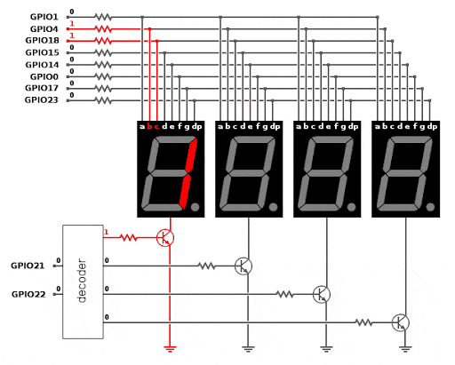
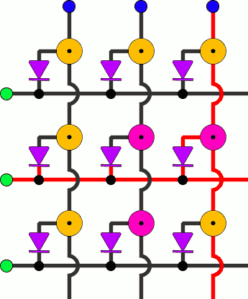
LAB 2: GPIO – LED 7 SEG – LED 14 SEG
1. SCAN 8 LED 7 SEG IN PARALLEL
SCANNING METHOD
STM32 EMBEDDED SYSTEMS
ARM CORTEX M

Slide 4
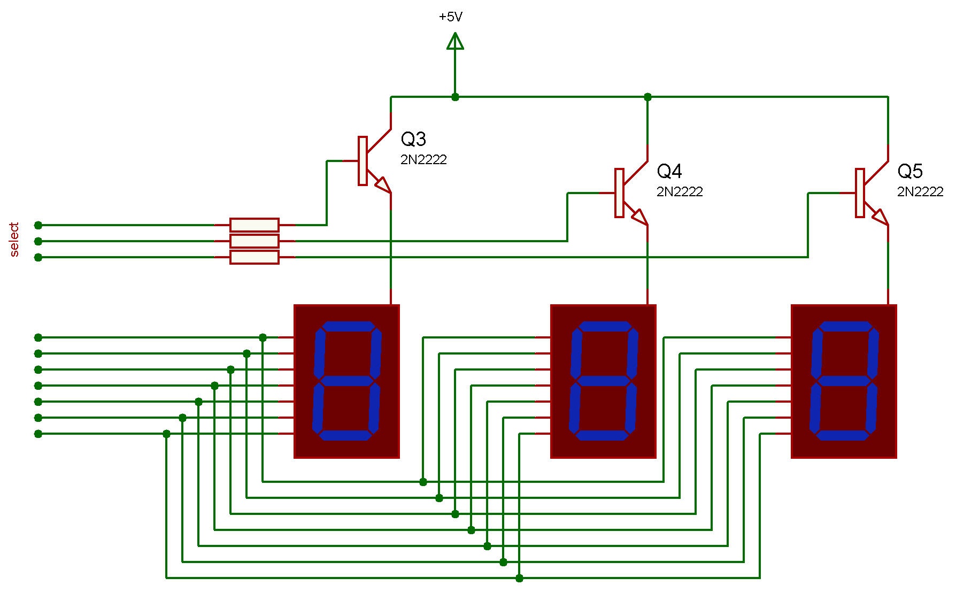
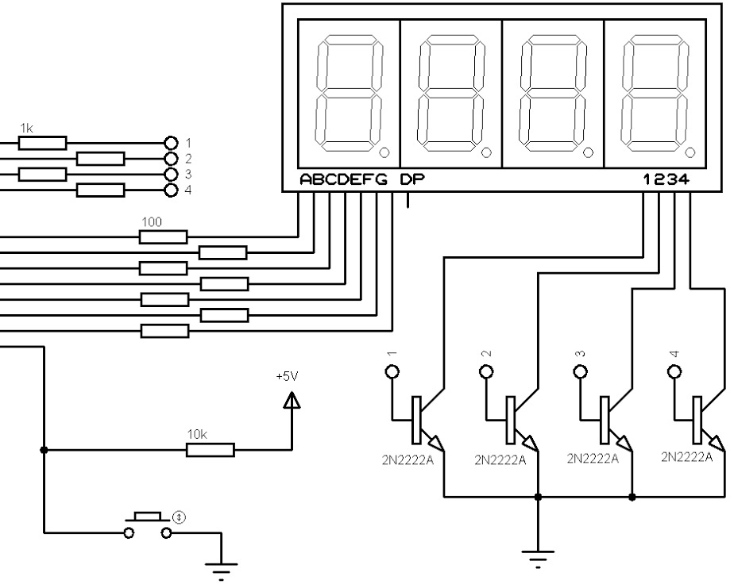
LAB 2: GPIO – LED 7 SEG – LED 14 SEG
1. SCAN 8 LED 7 SEG IN PARALLEL
SCANNING METHOD
STM32 EMBEDDED SYSTEMS
ARM CORTEX M

Slide 5
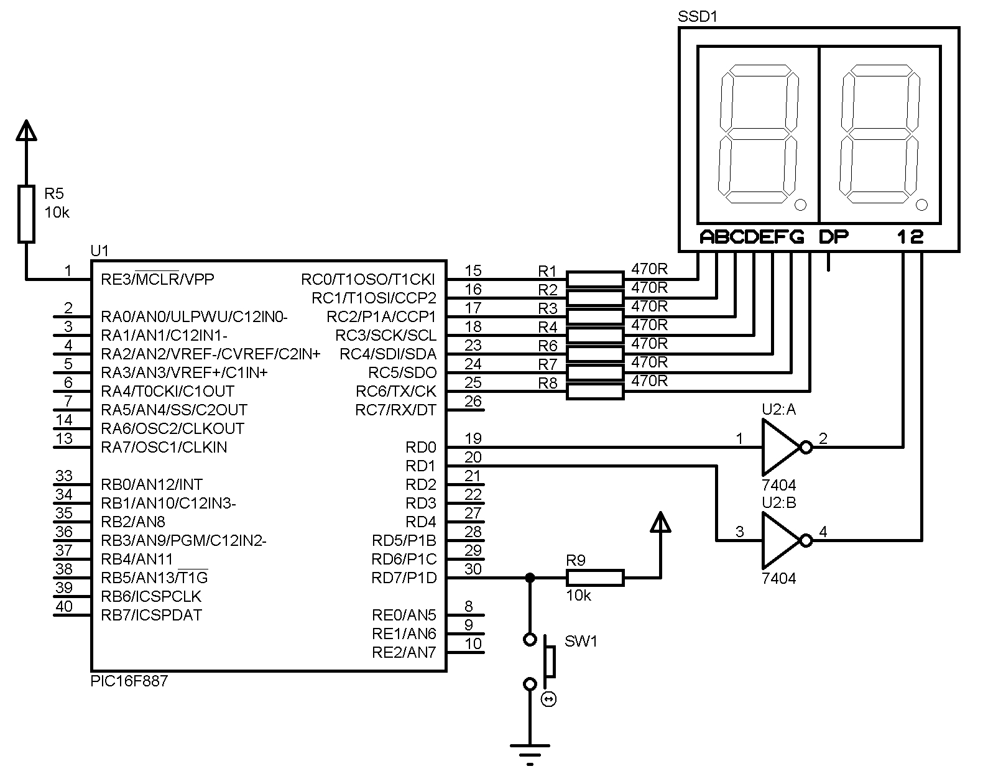
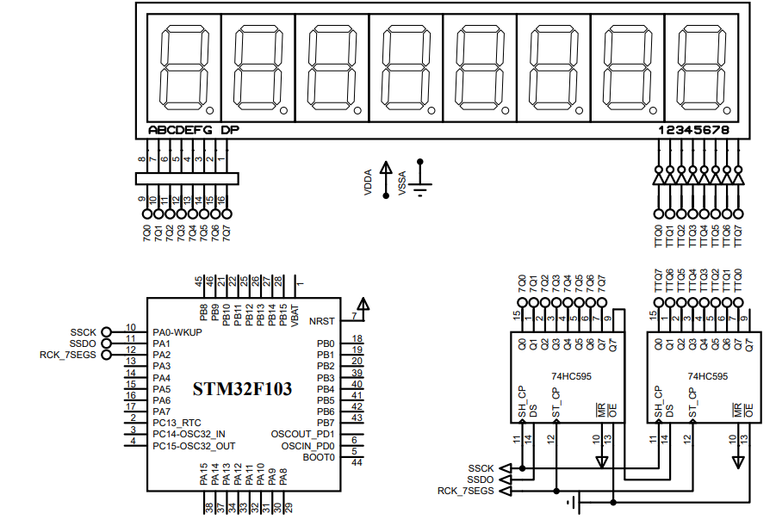
LAB 2: GPIO – LED 7 SEG – LED 14 SEG
1. SCAN 8 LED 7 SEG IN PARALLEL
SCANNING METHOD
STM32 EMBEDDED SYSTEMS
ARM CORTEX M

Slide 6
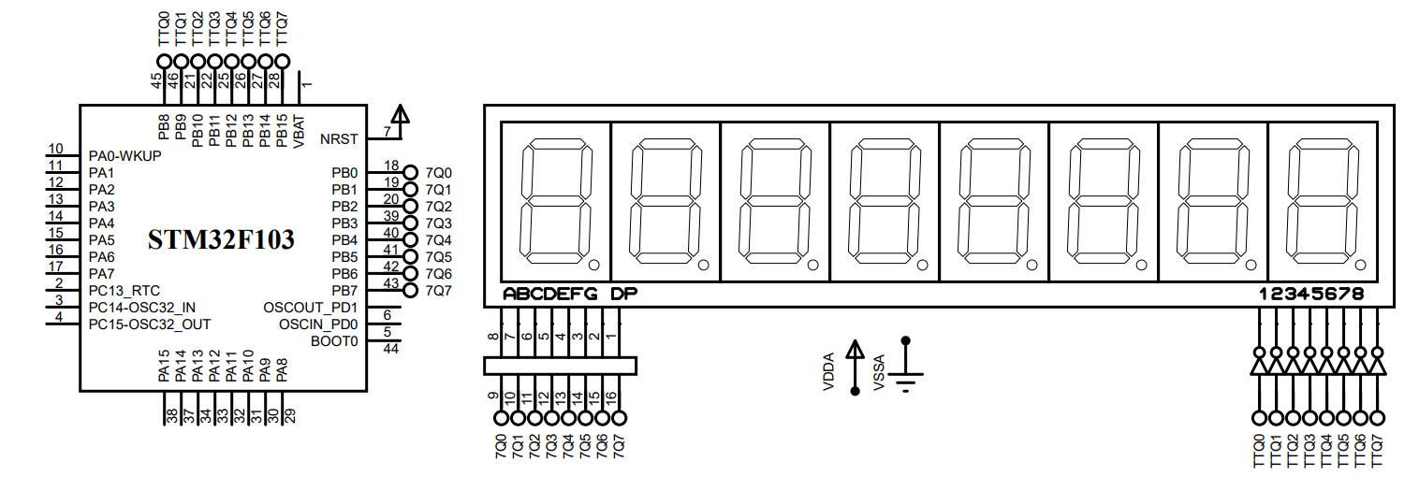
LAB 2: GPIO – LED 7 SEG – LED 14 SEG
1. SCAN 8 LED 7 SEG IN PARALLEL
SCANNING METHOD
STM32 EMBEDDED SYSTEMS
ARM CORTEX M

Slide 7
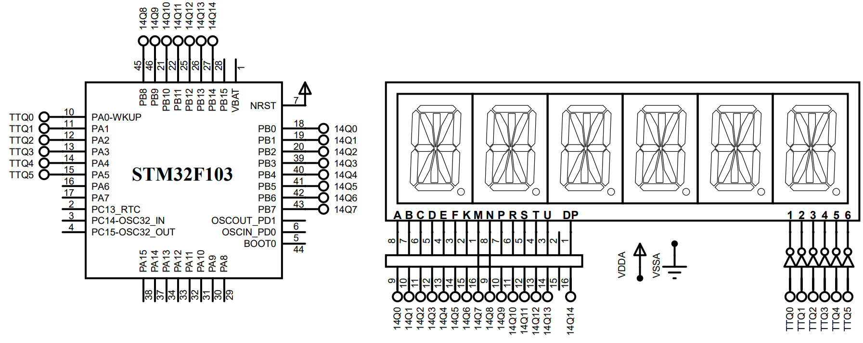
LAB 2: GPIO – LED 7 SEG – LED 14 SEG
1. SCAN 8 LED 7 SEG IN PARALLEL
SCANNING METHOD
STM32 EMBEDDED SYSTEMS
ARM CORTEX M

Slide 8
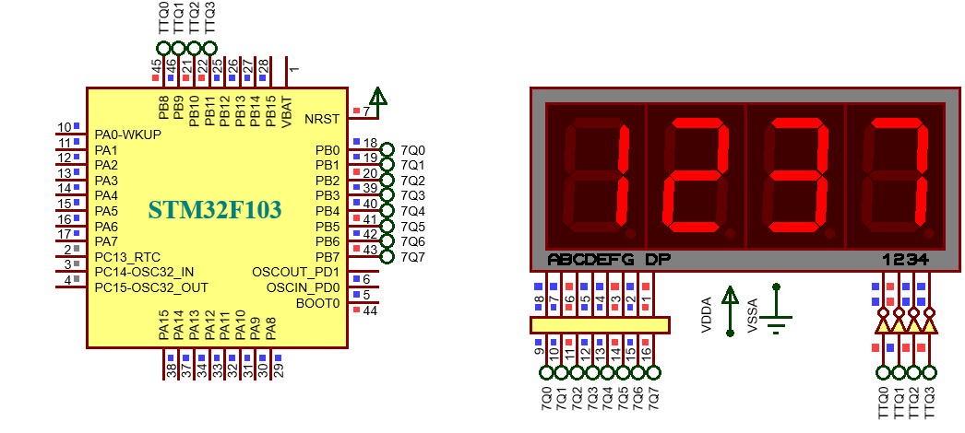
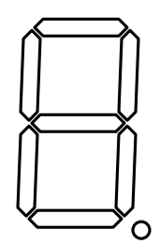
LAB 2: GPIO – LED 7 SEG – LED 14 SEG
1. SCAN 8 LED 7 SEG IN PARALLEL
DISPLAY 1 2 3 4
Write a program to control 4 led 7 seg in scanning method. The pins are used from B0 to B7 for display data, and B8 to B11 for scanning data.
1
32
2
64
16
4
128
8
STM32 EMBEDDED SYSTEMS
ARM CORTEX M

Slide 9
LAB 2: GPIO – LED 7 SEG – LED 14 SEG
P1. Write a program to control 4 led 7 seg in scanning method. The pins are used from B0 to B7 for display data, and B8 to B11 for scanning data.
void output_7seg(uint8_t data)
{
HAL_GPIO_WritePin(GPIOB, GPIO_PIN_7,(GPIO_PinState)(data&128)); HAL_GPIO_WritePin(GPIOB, GPIO_PIN_6,(GPIO_PinState)(data&64)); HAL_GPIO_WritePin(GPIOB, GPIO_PIN_5,(GPIO_PinState)(data&32)); HAL_GPIO_WritePin(GPIOB, GPIO_PIN_4,(GPIO_PinState)(data&16)); HAL_GPIO_WritePin(GPIOB, GPIO_PIN_3,(GPIO_PinState)(data&8)); HAL_GPIO_WritePin(GPIOB, GPIO_PIN_2,(GPIO_PinState)(data&4)); HAL_GPIO_WritePin(GPIOB, GPIO_PIN_1,(GPIO_PinState)(data&2)); HAL_GPIO_WritePin(GPIOB, GPIO_PIN_0,(GPIO_PinState)(data&1));
}
STM32 EMBEDDED SYSTEMS
ARM CORTEX M

Slide 10
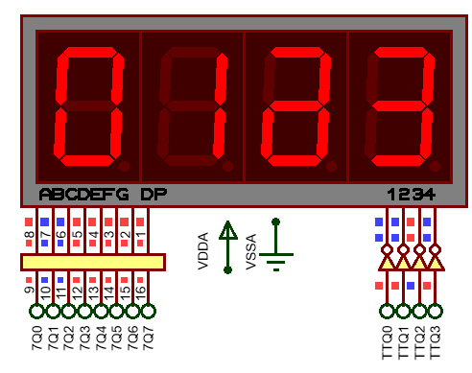
LAB 2: GPIO – LED 7 SEG – LED 14 SEG
P1. Write a program to control 4 led 7 seg in scanning method. The pins are used from B0 to B7 for display data, and B8 to B11 for scanning data.
char numc[10]= {0xc0,0xf9,0xa4,0xb0,0x99,0x92,0x82,0xf8,0x80,0x90};
char scan_code[5] = {0x07, 0x0b, 0x0d, 0x0e,0xff};
void output_scan(uint8_t data)
{
HAL_GPIO_WritePin(GPIOB, GPIO_PIN_8,(GPIO_PinState)(data&8)); HAL_GPIO_WritePin(GPIOB, GPIO_PIN_9,(GPIO_PinState)(data&4)); HAL_GPIO_WritePin(GPIOB, GPIO_PIN_10,(GPIO_PinState)(data&2)); HAL_GPIO_WritePin(GPIOB, GPIO_PIN_11,(GPIO_PinState)(data&1));
}
STM32 EMBEDDED SYSTEMS
ARM CORTEX M

Slide 11
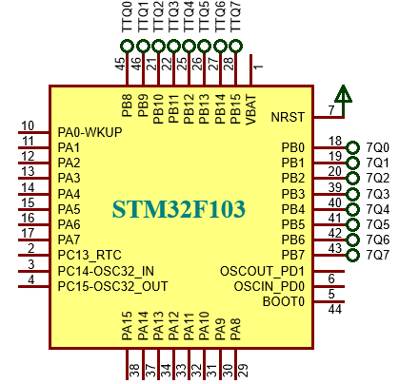
LAB 2: GPIO – LED 7 SEG – LED 14 SEG
P1. Write a program to control 4 led 7 seg in scanning method. The pins are used from B0 to B7 for display data, and B8 to B11 for scanning data.
output_scan(scan_code[0]); output_7seg(numc[0]);
HAL_Delay(5); output_scan(scan_code[4]);
output_scan(scan_code[1]); output_7seg(numc[1]);
HAL_Delay(5); output_scan(scan_code[4]);
output_scan(scan_code[2]); output_7seg(numc[2]);
HAL_Delay(5); output_scan(scan_code[4]);
output_scan(scan_code[3]); output_7seg(numc[3]);
HAL_Delay(5); output_scan(scan_code[4]);
STM32 EMBEDDED SYSTEMS
ARM CORTEX M

Slide 12
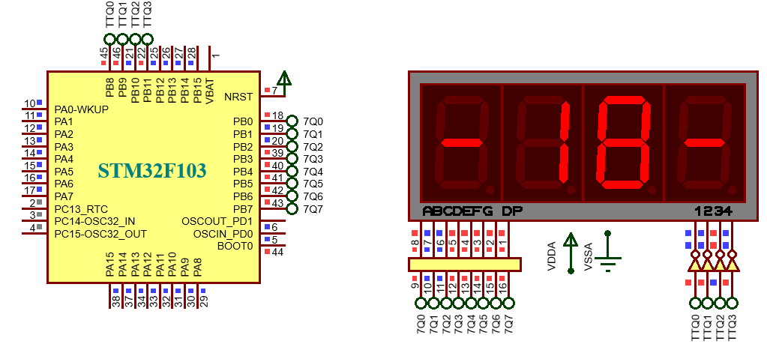
LAB 2: GPIO – LED 7 SEG – LED 14 SEG
P2. Modify the program P1, to make a function “led7seg_display();” to display 4 digit number in 4 led respectively 4 variable: led7_seg[0], led7_seg[1], led7_seg[2], led7_seg[3]. Then display the form:
“ - 18 – “.
char led7_segs[4] = {0xff,0xff,0xff,0xff};
void led7seg_display(void)
{
for(uint8_t p=0; p<4; p++)
{
output_scan(scan_code[p]);
output_7seg(led7_segs[p]);
HAL_Delay(5);
output_scan(scan_code[4]);
}
}
STM32 EMBEDDED SYSTEMS
ARM CORTEX M

Slide 13
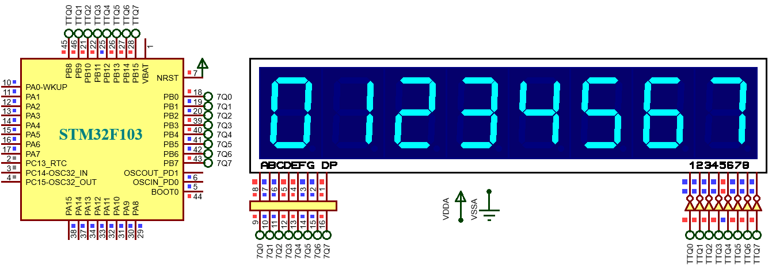
LAB 2: GPIO – LED 7 SEG – LED 14 SEG
P3. Expand the number of led to 8, write the function “output_7seg(data);” to put the display data and function “output_scan(scan_data);” to put the scanning data. Then display the numbers from 0 to 7 on this.
STM32 EMBEDDED SYSTEMS
ARM CORTEX M

Slide 14
LAB 2: GPIO – LED 7 SEG – LED 14 SEG
P3. Expand the number of led to 8, write the function “output_7seg(data);” to put the display data and function “output_scan(scan_data);” to put the scanning data. Then display the numbers from 0 to 7 on this.
char scan_code[9] = {0x7f,0xbf,0xdf,0xef,0xf7,0xfb,0xfd,0xfe,0xff};
void output_7seg(uint8_t data);
void output_scan(uint8_t data);
output_scan(scan_code[0]);
output_7seg(numc[0]);
HAL_Delay(5);
output_scan(scan_code[8]);
STM32 EMBEDDED SYSTEMS
ARM CORTEX M

Slide 15
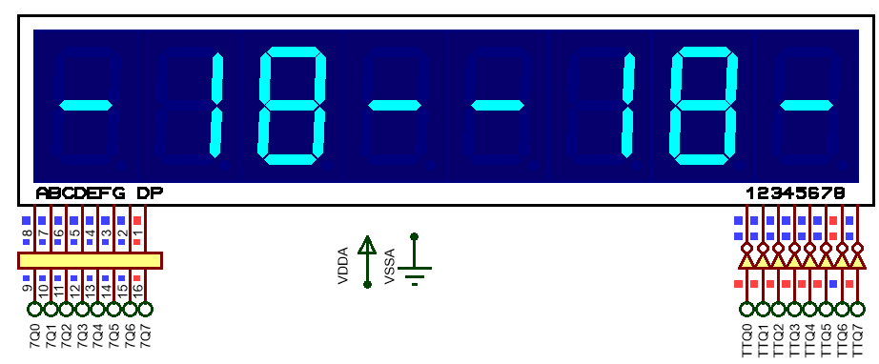
LAB 2: GPIO – LED 7 SEG – LED 14 SEG
P4. Modify the program P3 to make a function “led7seg_display();” to display 8 digit number respectively variables of array led7_seg[8];
char led7_segs[8] =
{0xff,0xff,0xff,0xff,0xff,0xff,0xff,0xff};
void led7segs_display(void)
{
for(uint8_t p=0; p<8; p++)
{
output_scan(scan_code[p]);
output_7seg(led7_segs[p]);
HAL_Delay(5);
output_scan(scan_code[8]);
}
}
STM32 EMBEDDED SYSTEMS
ARM CORTEX M

Slide 16
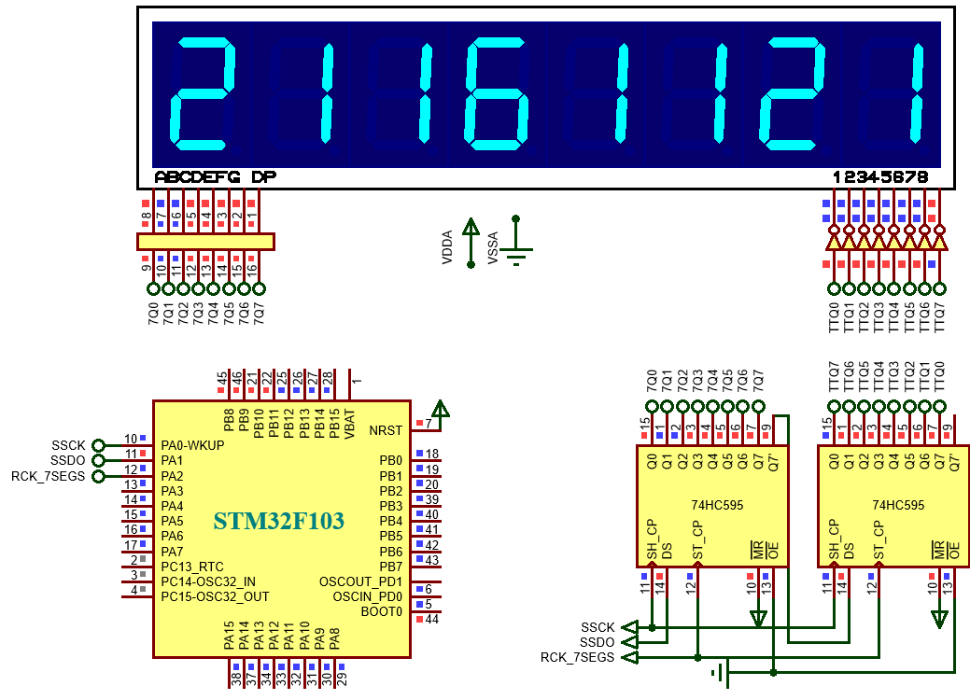
LAB 2: GPIO – LED 7 SEG – LED 14 SEG
2. SCAN 8 LED 7 SEG IN SERIAL
P5. Write a program to control 8 led in scanning method using the shift register 74HC595. Using function “put_1byte(data);”
1
32
2
64
16
4
128
8
STM32 EMBEDDED SYSTEMS
ARM CORTEX M

Slide 17
LAB 2: GPIO – LED 7 SEG – LED 14 SEG
2. SCAN 8 LED 7 SEG IN SERIAL
P5. Write a program to control 8 led in scanning method using the shift register 74HC595. Using function “put_1byte(data);”
char numc[10]= {0xc0,0xf9,0xa4,0xb0,0x99,0x92,0x82,0xf8,0x80,0x90};
char scan_code[9] = {0x7f,0xbf,0xdf,0xef,0xf7,0xfb,0xfd,0xfe,0xff};
char led7_segs[8] = {0xff,0xff,0xff,0xff,0xff,0xff,0xff,0xff};
void put1_byte(uint8_t byte)
{
for(uint8_t i = 0; i < 8; i++)
{
HAL_GPIO_WritePin(GPIOA, GPIO_PIN_1,(GPIO_PinState)(byte&(0x80 >> i)));
HAL_GPIO_WritePin(GPIOA, GPIO_PIN_0, GPIO_PIN_SET );
HAL_GPIO_WritePin(GPIOA, GPIO_PIN_0, GPIO_PIN_RESET ); }
}
STM32 EMBEDDED SYSTEMS
ARM CORTEX M

Slide 18
LAB 2: GPIO – LED 7 SEG – LED 14 SEG
2. SCAN 8 LED 7 SEG IN SERIAL
void led7segs_display(void) {
for(uint8_t i=0; i<8; i++)
{
put1_byte(scan_code[i]);
put1_byte(led7_segs[i]);
HAL_GPIO_WritePin(GPIOA, GPIO_PIN_2, GPIO_PIN_SET); HAL_GPIO_WritePin(GPIOA, GPIO_PIN_2, GPIO_PIN_RESET);
HAL_Delay(5);
put1_byte(scan_code[8]);
put1_byte(0xff);
HAL_GPIO_WritePin(GPIOA, GPIO_PIN_2, GPIO_PIN_SET); HAL_GPIO_WritePin(GPIOA, GPIO_PIN_2, GPIO_PIN_RESET);
}
}
STM32 EMBEDDED SYSTEMS
ARM CORTEX M

Slide 19
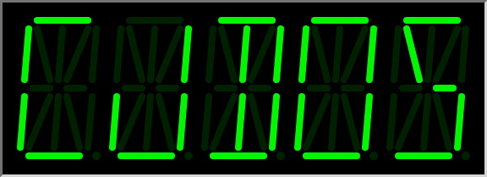

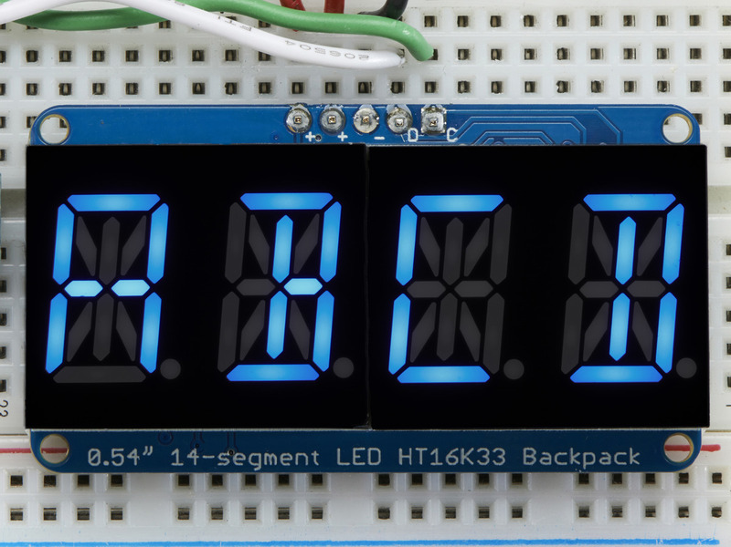
LAB 2: GPIO – LED 7 SEG – LED 14 SEG
3. SCAN 14 LED 7 SEG IN SERIAL
0
5
6
7
8
1
13
9
12
11
10
2
4
3
STM32 EMBEDDED SYSTEMS
ARM CORTEX M

Slide 20
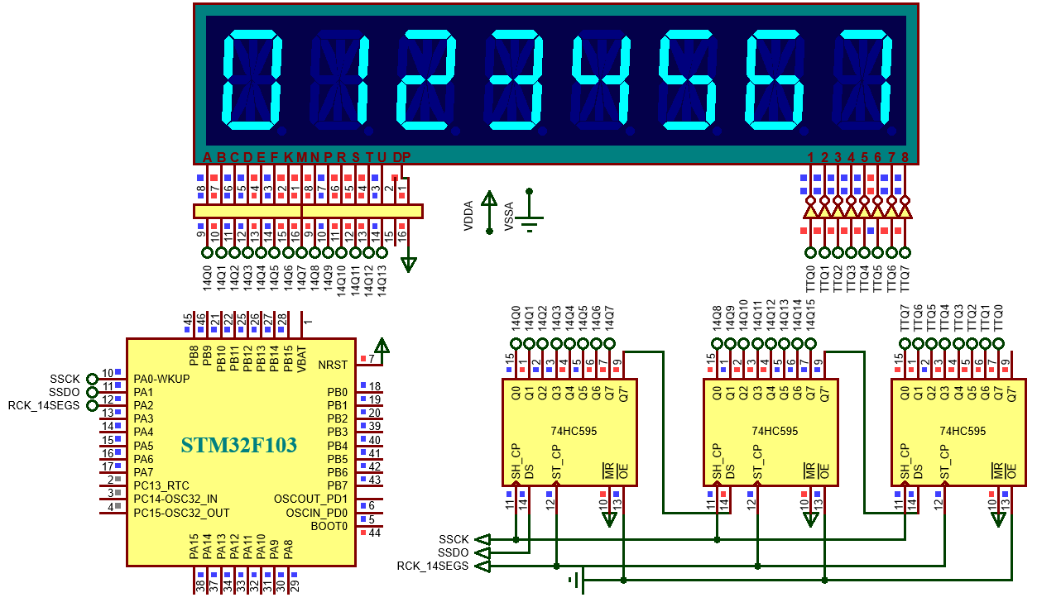
LAB 2: GPIO – LED 7 SEG – LED 14 SEG
3. SCAN 14 LED 7 SEG IN SERIAL
P6. Write a program to control 8 led in scanning method using the shift register 74HC595. Using function “put_1byte(data);”
STM32 EMBEDDED SYSTEMS
ARM CORTEX M

Slide 21
LAB 2: GPIO – LED 7 SEG – LED 14 SEG
3. SCAN 14 LED 7 SEG IN SERIAL
const uint16_t num14[10]=
{16320,16377,7652, 7664,7641, 7634, 7618, 16376,7616, 7632}; char scan_code[9]= {0x7f,0xbf,0xdf,0xef,0xf7,0xfb,0xfd,0xfe,0xff};
uint16_t led14_segs[8] = {0xffff,0xffff,0xffff,0xffff,0xffff,0xffff,0xffff,0xffff};
void put1_byte(uint8_t byte)
{
for(uint8_t i = 0; i < 8; i++)
{
HAL_GPIO_WritePin(GPIOA, GPIO_PIN_1,(GPIO_PinState)(byte&(0x80 >> i)));
HAL_GPIO_WritePin(GPIOA, GPIO_PIN_0, GPIO_PIN_SET );
HAL_GPIO_WritePin(GPIOA, GPIO_PIN_0, GPIO_PIN_RESET );
}
}
STM32 EMBEDDED SYSTEMS
ARM CORTEX M

Slide 22
LAB 2: GPIO – LED 7 SEG – LED 14 SEG
3. SCAN 14 LED 7 SEG IN SERIAL
void led14seg_display(void) {
for(uint8_t i=0; i<8; i++)
{
put1_byte(scan_code[i]); put1_byte(led14_segs[i]>>8); put1_byte(led14_segs[i]);
HAL_GPIO_WritePin(GPIOA,GPIO_PIN_2, GPIO_PIN_SET); HAL_GPIO_WritePin(GPIOA,GPIO_PIN_2, GPIO_PIN_RESET); HAL_Delay(5);
put1_byte(scan_code[8]); put1_byte(0xff);
put1_byte(0xff);
HAL_GPIO_WritePin(GPIOA,GPIO_PIN_2, GPIO_PIN_SET); HAL_GPIO_WritePin(GPIOA,GPIO_PIN_2, GPIO_PIN_RESET);
}
}
STM32 EMBEDDED SYSTEMS
ARM CORTEX M

Slide 23
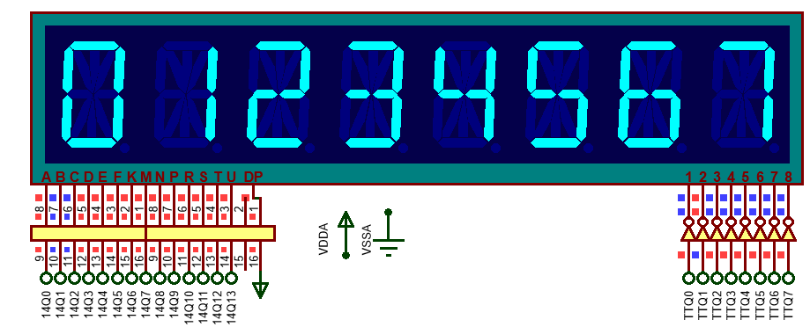
LAB 2: GPIO – LED 7 SEG – LED 14 SEG
3. SCAN 14 LED 7 SEG IN SERIAL
led14_segs[0] = num14[0]; led14_segs[1] = num14[1]; led14_segs[2] = num14[2]; led14_segs[3] = num14[3]; led14_segs[4] = num14[4]; led14_segs[5] = num14[5]; led14_segs[6] = num14[6]; led14_segs[7] = num14[7]; led14seg_display();
STM32 EMBEDDED SYSTEMS
ARM CORTEX M

Slide 24
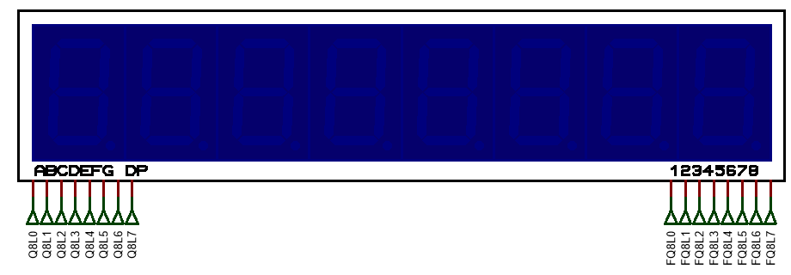
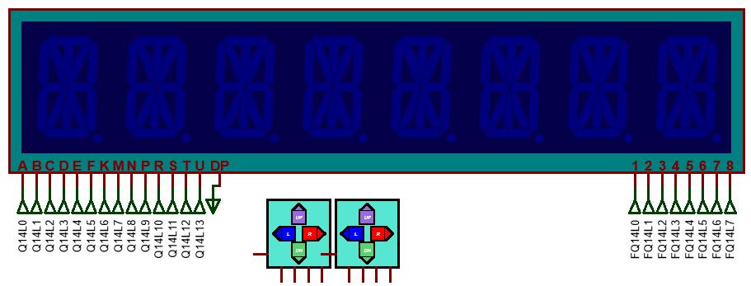
LAB 2: GPIO – LED 7 SEG – LED 14 SEG
BOARD PRACTISE
uint8_t led7_segs[8] = {0xff, 0xff, 0xff, 0xff,0xff, 0xff, 0xff, 0xff};
uint16_t led14_segs[8] = {0xffff, 0xffff, 0xffff, 0xffff,0xffff, 0xffff, 0xffff, 0xffff};
void led7segs_display(void);
void led14segs_display(void);
STM32 EMBEDDED SYSTEMS
ARM CORTEX M

